Slide 1
What if emerging technologies had always been regulated ?
A light-hearted look at emerging
technologies last century

Slide 2
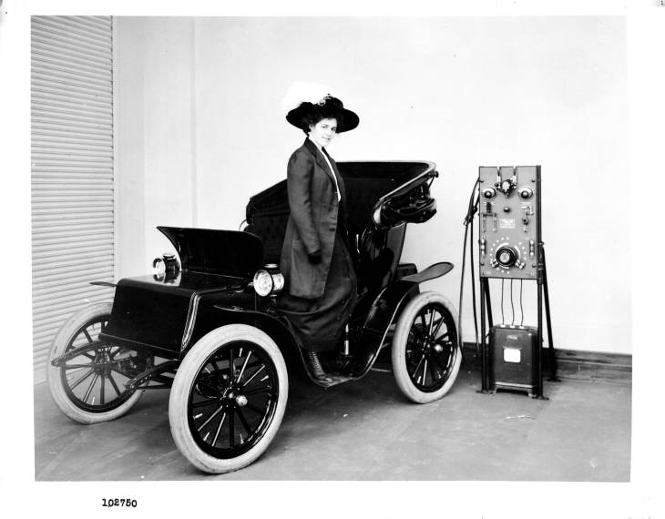
Charging an EV from a mercury-arc rectifier, possibly early 1900’s
Actually … rolling this into the RAB would create an unfair subsidy to us EV drivers…

Slide 3
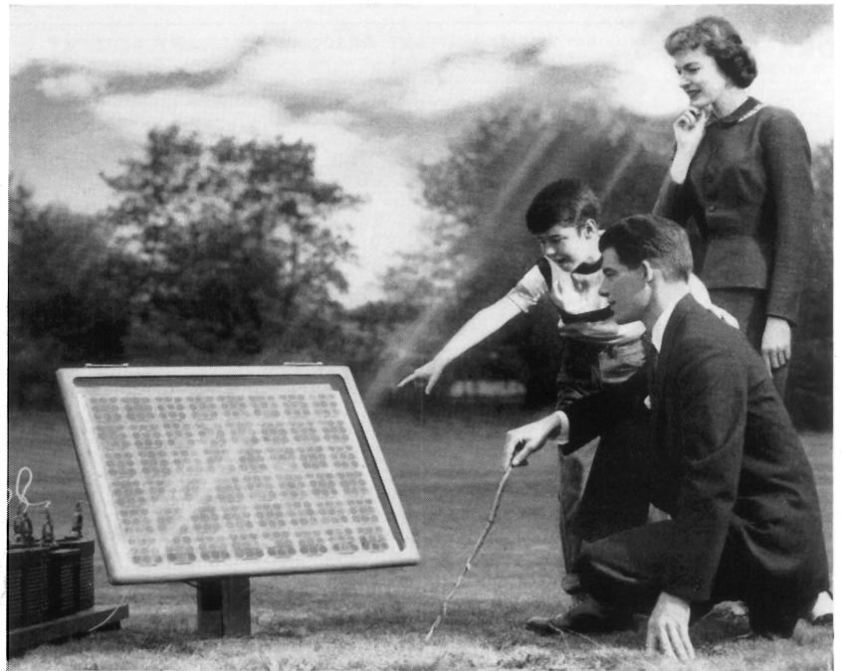
Family admiring an early PV array, possibly 1950’s
But daddy, won’t a higher
monthly access charge undermine
the value proposition ?

Slide 4
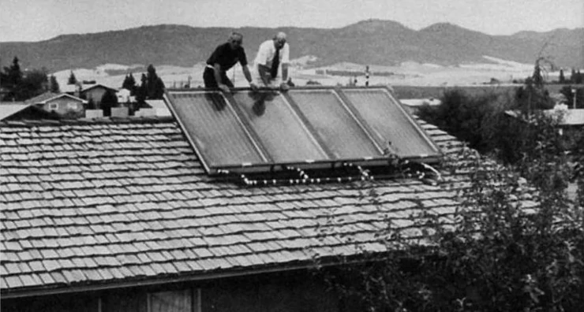
Family admiring an early PV array, possibly 1950’s
Y’know, this really needs
to be facing north-west so it
offsets our air-con demand…

Slide 5
Marlborough Electric Power Board erecting its first concrete pole, 1920’s
For serious insights on emerging technologies, contact Phil Caffyn…
Phone +64 - 7 - 8546541
Email phil@utilityconsultants.co.nz
Web www.utilityconsultants.co.nz

